Slide 1
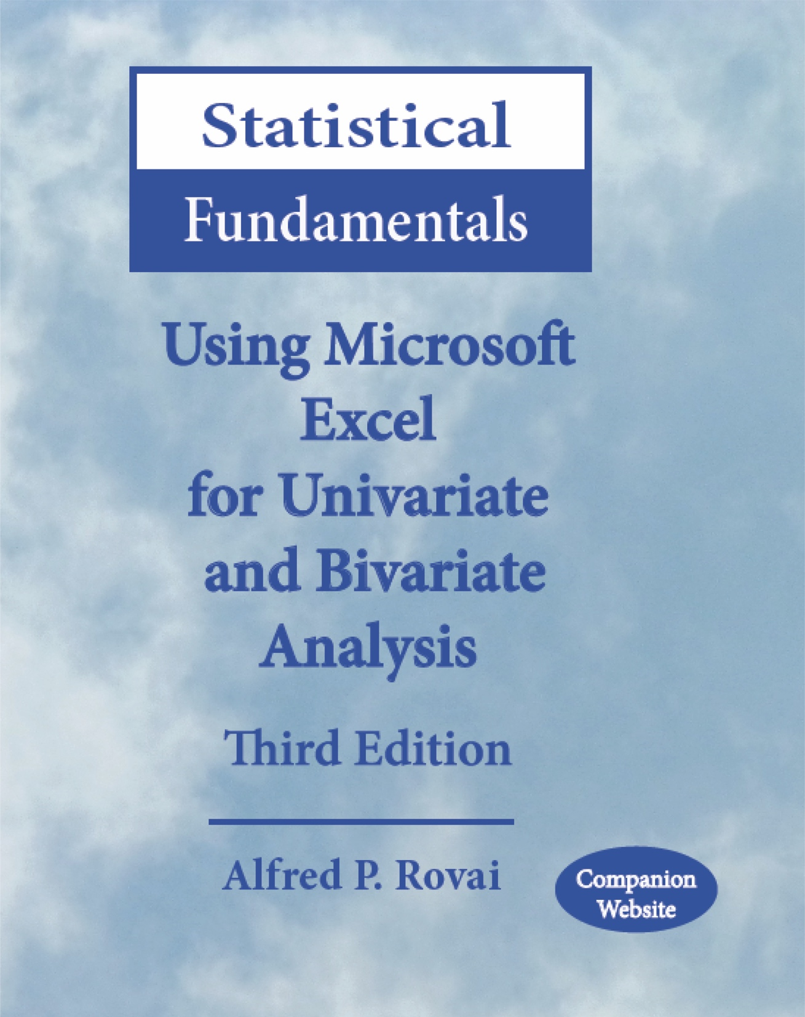
Statistical Fundamentals:
Using Microsoft Excel for Univariate and Bivariate Analysis
Alfred P. Rovai
Descriptive Statistics - Measures of Dispersion
PowerPoint Prepared by
Alfred P. Rovai
Microsoft® Excel® Screen Prints Courtesy of Microsoft Corporation.

Slide 2
Descriptive Statistics
Statistics
  Summary measures calculated for a sample dataset.
Parameters
  Summary measures calculated for a population dataset.
Used to describe variables
  Measures of central tendency, e.g., mean, median, mode
  Measures of dispersion, e.g., standard deviation, variance, range
  Measures of relative position, e.g., percentile, quartile
  Graphs and charts, e.g., scatterplot, column chart, histogram

Slide 3
Measures of Dispersion
Designed to give information concerning the amount of dispersion of scores about a central value.
Researchers typically report the best measures of central tendency and dispersion for each variable. The best measure to report varies based on the shape of a variable’s distribution and scale of measurement.
  Interval/ratio data – standard deviation, variance, and range can be calculated and reported, as appropriate.
  Ordinal/nominal data - range can and should be reported; use of the standard deviation or variance is wrong.
 | Measures of Dispersion
Nominal data | Range
Ordinal data | Range
Interval data | Standard Deviation, Variance, Range
Ratio data | Standard Deviation, Variance, Range

Slide 4
Standard Deviation (S, SD, σ)
Indicates how much scores deviate below and above the mean
For normally distributed data
  68.2% of the distribution falls within ± 1 SD of the mean
  95.4% of the distribution falls within ± 2 SD of the mean
  99.6%of the distribution falls within ± 3 SD of the mean
Formulas
(Note: dividing by (N – 1) rather than N for sample standard deviation results in an unbiased estimate of population standard deviation.)
Excel functions:
STDEV.S(number1,number2,...). Returns the unbiased estimate of population standard deviation, where numbers represent the range of numbers
STDEV.P (number1,number2,...). Returns the population standard deviation, where numbers represent the range of numbers

Slide 5
Example of Standard Deviation
For an unbiased estimate of the population standard deviation, N – 1 is used in the formula in place of N, otherwise the formula will underestimate the population sum of squares.

Slide 6
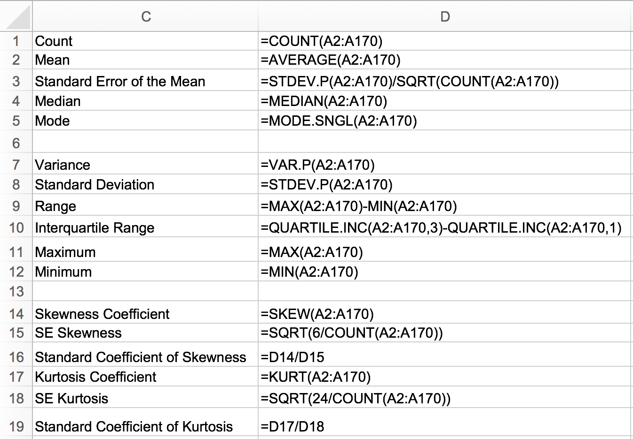
TASK
Enter the following formula in cell D8 to calculate the standard deviation for c_community:
=STDEV.P(A2:A170)
Note: this measure is not an unbiased estimate of the population SD. If an unbiased estimate of the population SD is desired use the formula =STDEV.S(A2:A170).

Slide 7
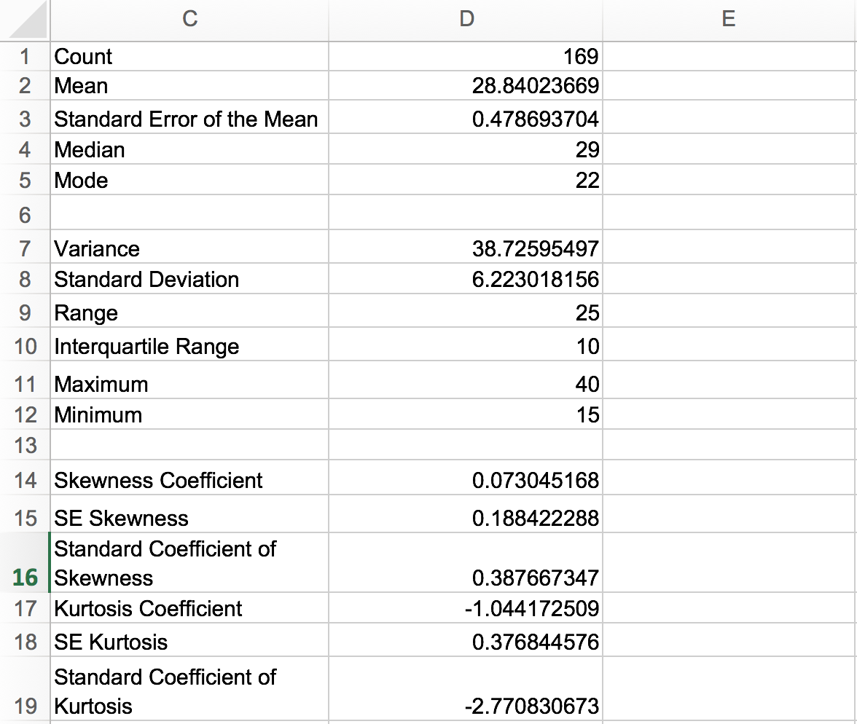
Excel displays the SD as 6.223018156. This sample statistic is typically reported as SD = 6.22 in the results section of a research paper, as appropriate. It represents a measure of the spread of the distribution.

Slide 8
Variance (S², σ²)
Variance is the average of each score’s squared difference from the mean.
Not a very useful as a descriptive statistic. Important value used in certain techniques (e.g., the analysis of variance or ANOVA)
The formula for the population and sample variances are given below.
(Note: dividing by (N – 1) rather than N for sample variance results in an unbiased estimate of population variance.)
Excel functions:
VAR.S(number1,number2,...). Returns the unbiased estimate of population variance, with numbers representing the range of numbers.
VAR.P (number1,number2,...). Returns the population variance, with numbers representing the range of numbers.

Slide 9
Example of Variance
For an unbiased estimate of the population standard deviation, N – 1 is used in the formula in place of N, otherwise the formula will underestimate the population sum of squares.

Slide 10
TASK
Enter the following formula in cell D8 to calculate the variance of variable c_community:
=VAR.P(A2:A170)
Note: this measure is not an unbiased estimate of the population variance. If an unbiased estimate of the population variance is desired use the formula =VAR.S(A2:A170).

Slide 11
Excel displays the variance as 38.72595497. Like the SD, it It represents a measure of the spread of the distribution.

Slide 12
Range
The range of a distribution is calculated by subtracting the minimum score from the maximum score.
The range is not very stable (reliable) because it is based on only two scores. Consequently, outliers have a significant effect on the range of a variable.
Excel formula:
=MAX(number1,number2,...)–MIN(number1,number2,...)
Note: MAX(number1,number2,...) returns the maximum value in a set of numbers and MIN(number1,number2,...) returns the minimum value in a set of numbers.

Slide 13
Example of Range
Range = maximum value – minimum value = 8 – 5 = 3

Slide 14
TASK
Enter the following formula in cell D9 to calculate the range of variable c_community:
=MAX(A2:A170)-MIN(A2:A170)

Slide 15
Excel displays the range as 25. This statistics is a measure of the spread of the distibution; specifically maximum value minus minimum value.

Slide 16
Descriptive Statistics - Dispersion
End of Presentation

